Slide 1
1
Displaying Data
from Multiple Tables
Badgujar Dipak D

Slide 2

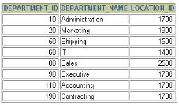



Obtaining Data from Multiple Tables
EMPLOYEES DEPARTMENTS
…
…
1-121
Badgujar Dipak D

Slide 3
Cartesian Products
A Cartesian product is formed when:
A join condition is omitted
A join condition is invalid
All rows in the first table are joined to all rows in the second table
To avoid a Cartesian product, always include a valid join condition in a WHERE clause.
1-122
Badgujar Dipak D

Slide 4
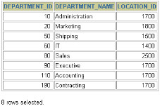

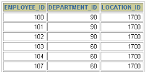
Generating a Cartesian Product
EMPLOYEES (20 rows) DEPARTMENTS (8 rows)
…
Cartesian product: 20x8=160 rows
…
1-123
Badgujar Dipak D

Slide 5


Types of Joins
Oracle Proprietary Joins (8i and prior):
SQL: 1999
Compliant Joins:
Equijoin
Non-equijoin
Outer join
Self join
Cross joins
Natural joins
Using clause
Full or two sided outer joins
Arbitrary join conditions for outer joins
1-124
Badgujar Dipak D

Slide 6


Joining Tables Using Oracle Syntax
Use a join to query data from more than one table.
SELECT table1.column, table2.column
FROM table1, table2
WHERE table1.column1 = table2.column2;
Write the join condition in the WHERE clause.
Prefix the column name with the table name when the same column name appears in more than one table.
1-125
Badgujar Dipak D

Slide 7
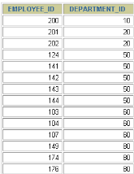
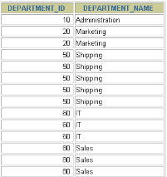
What is an Equijoin?
EMPLOYEES
DEPARTMENTS
…
…
Foreign key Primary key
1-126
Badgujar Dipak D

Slide 8

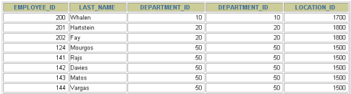
Retrieving Records with Equijoins
SELECT employees.employee_id, employees.last_name, employees.department_id, departments.department_id, departments.location_id FROM employees, departments
WHERE | employees.department_id = departments.department_id
;
…
1-127
Badgujar Dipak D

Slide 9
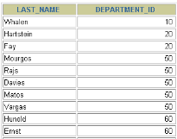
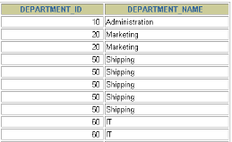
Additional Search Conditions Using the AND Operator
EMPLOYEES DEPARTMENTS
…
…
1-128
Badgujar Dipak D

Slide 10
Qualifying Ambiguous Column Names
Use table prefixes to qualify column names that are in multiple tables.
Improve performance by using table prefixes.
Distinguish columns that have identical names but reside in different tables by using column aliases.
1-129
Badgujar Dipak D

Slide 11

Using Table Aliases
Simplify queries by using table aliases.
Improve performance by using table prefixes.
SELECT e.employee_id, e.last_name, e.department_id, d.department_id, d.location_id
FROM employees e , departments d
WHERE e.department_id = d.department_id;
1-130
Badgujar Dipak D

Slide 12
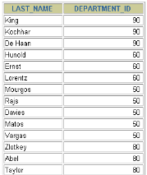
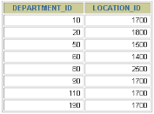

Joining More than Two Tables
EMPLOYEES
DEPARTMENTS LOCATIONS
…
To join n tables together, you need a minimum of n-1 join conditions. For example, to join three tables, a minimum of two joins is required.
1-131
Badgujar Dipak D

Slide 13
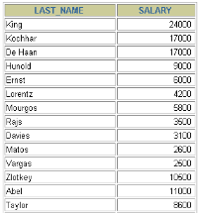
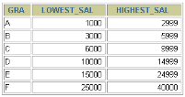
Non-Equijoins
EMPLOYEES
JOB_GRADES
Salary in the EMPLOYEES table must be between lowest salary and highest salary in the JOB_GRADES table.
…
1-132
Badgujar Dipak D

Slide 14

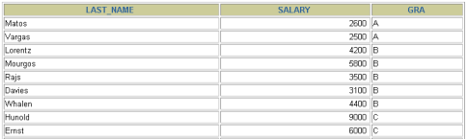
Retrieving Records with Non-Equijoins
SELECT e.last_name, e.salary, j.grade_level FROM employees e, job_grades j WHERE e.salary
 | BETWEEN j.lowest_sal AND j.highest_sal | ;
…
1-133
Badgujar Dipak D

Slide 15
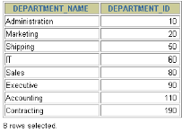
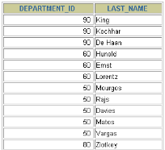
Outer Joins
DEPARTMENTS
EMPLOYEES
…
There are no employees in department 190.
1-134
Badgujar Dipak D

Slide 16




Outer Joins Syntax
You use an outer join to also see rows that do not meet the join condition.
The Outer join operator is the plus sign (+).
SELECT table1.column, table2.column
FROM table1, table2
WHERE table1.column(+) = table2.column;
SELECT table1.column, table2.column
FROM table1, table2
WHERE table1.column = table2.column(+);
1-135
Badgujar Dipak D

Slide 17

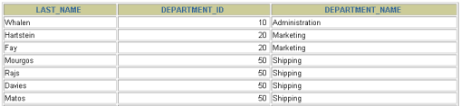
Using Outer Joins
SELECT e.last_name, e.department_id, d.department_name FROM employees e, departments d
WHERE ;
e.department_id(+) = d.department_id
…
1-136
Badgujar Dipak D

Slide 18
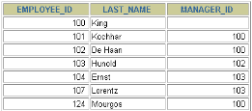
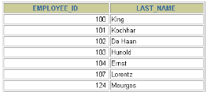
Self Joins
EMPLOYEES (WORKER)
EMPLOYEES (MANAGER)
…
…
MANAGER_ID in the WORKER table is equal to
EMPLOYEE_ID in the MANAGER table.
1-137
Badgujar Dipak D

Slide 19

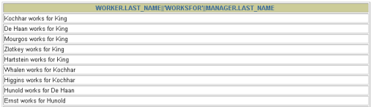
Joining a Table to Itself
SELECT worker.last_name || ' works for ' || manager.last_name FROM employees worker, employees manager
WHERE | worker.manager_id = manager.employee_id | ;
…
1-138
Badgujar Dipak D

Slide 20


Creating Cross Joins
The CROSS JOIN clause produces the cross- product of two tables.
This is the same as a Cartesian product between the two tables.
SELECT last_name, department_name FROM employees
 | CROSS JOIN departments | ;
…
1-139
Badgujar Dipak D

Slide 21
Creating Natural Joins
The NATURAL JOIN clause is based on all columns in the two tables that have the same name.
It selects rows from the two tables that have equal values in all matched columns.
If the columns having the same names have different data types, an error is returned.
1-140
Badgujar Dipak D

Slide 22

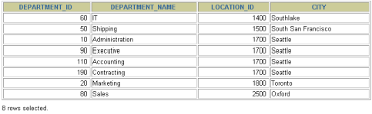
Retrieving Records with Natural Joins
SELECT department_id, department_name, location_id, city
FROM departments
NATURAL JOIN locations
;
1-141
Badgujar Dipak D

Slide 23
Creating Joins with the USING Clause
If several columns have the same names but the data types do not match, the NATURAL JOIN clause can be modified with the USING clause to specify the columns that should be used for an equijoin.
Use the USING clause to match only one column when more than one column matches.
Do not use a table name or alias in the referenced columns.
The NATURAL JOIN and USING clauses are mutually exclusive.
1-142
Badgujar Dipak D

Slide 24

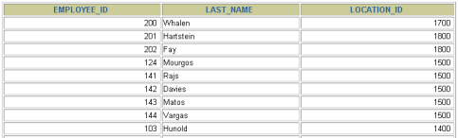
Retrieving Records with the USING Clause
SELECT e.employee_id, e.last_name, d.location_id
FROM
employees e JOIN departments d
;
USING (department_id)
…
1-143
Badgujar Dipak D

Slide 25
Creating Joins with the ON Clause
The join condition for the natural join is basically an equijoin of all columns with the same name.
To specify arbitrary conditions or specify columns to join, the ON clause is used.
The join condition is separated from other search
conditions.
The ON clause makes code easy to understand.
1-144
Badgujar Dipak D

Slide 26

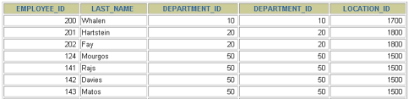
Retrieving Records with the ON Clause
SELECT e.employee_id, e.last_name, e.department_id, d.department_id, d.location_id
FROM employees e JOIN departments d
ON (e.department_id = d.department_id);
…
1-145
Badgujar Dipak D

Slide 27

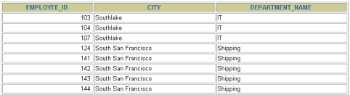
Creating Three-Way Joins with the ON
Clause
JOIN departments d
ON d.department_id = e.department_id JOIN locations l
ON d.location_id = l.location_id;
SELECT employee_id, city, department_name FROM employees e
…
1-146
Badgujar Dipak D

Slide 28
INNER Versus OUTER Joins
In SQL: 1999, the join of two tables returning only matched rows is an inner join.
A join between two tables that returns the results of the inner join as well as unmatched rows left (or right) tables is a left (or right) outer join.
A join between two tables that returns the results of an inner join as well as the results of a left and right join is a full outer join.
1-147
Badgujar Dipak D

Slide 29



LEFT OUTER JOIN
SELECT e.last_name, e.department_id, d.department_name FROM employees e
LEFT OUTER JOIN departments d
ON (e.department_id = d.department_id)
;
…
1-148
Badgujar Dipak D

Slide 30

RIGHT OUTER JOIN
SELECT e.last_name, e.department_id, d.department_name FROM employees e
RIGHT OUTER JOIN departments d
ON (e.department_id = d.department_id)
;
…
1-149
Badgujar Dipak D

Slide 31
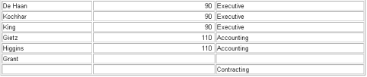
FULL OUTER JOIN
SELECT e.last_name, e.department_id, d.department_name FROM employees e
FULL OUTER JOIN departments d
ON (e.department_id = d.department_id
) ;
…
1-150
Badgujar Dipak D

Slide 32


Additional Conditions
SELECT e.employee_id, e.last_name, e.department_id, d.department_id, d.location_id
FROM employees e JOIN departments d
ON (e.department_id = d.department_id)
AND e.manager_id = 149
;
1-151
Badgujar Dipak D

